Slide 1
Mobile Money Fraud Detection in Rwanda
Capstone Project Presentation
MUGISHA Leopold
26636

Slide 2
Problem Statement
Can machine learning detect suspicious mobile money transactions in Rwanda?
Goal: Detect fraud in financial transactions using unsupervised learning.
Dataset: Synthetic Mobile Money Transaction Dataset (from Mendeley Data).
Tools: Python, VS Code, Power BI.
Output: Cleaned data, anomaly labels, charts, and performance metrics.

Slide 3
Dataset Overview
Title: Synthetic Mobile Money Transaction Dataset
Source: Mendeley Data
Rows: ~1.7 million | Columns: 10
Features: amount, isFraud, initiator, balance before/after, step (time)

Slide 4
Data Cleaning
Removed nulls & infinite values
Converted timestamp columns
Saved to outputs/cleaned_data.csv

Slide 5
Exploratory Data Analysis (EDA)
Generated visual insights:
- Transaction amount distribution
- Fraud vs Non-Fraud count
- Correlation heatmap

Slide 6
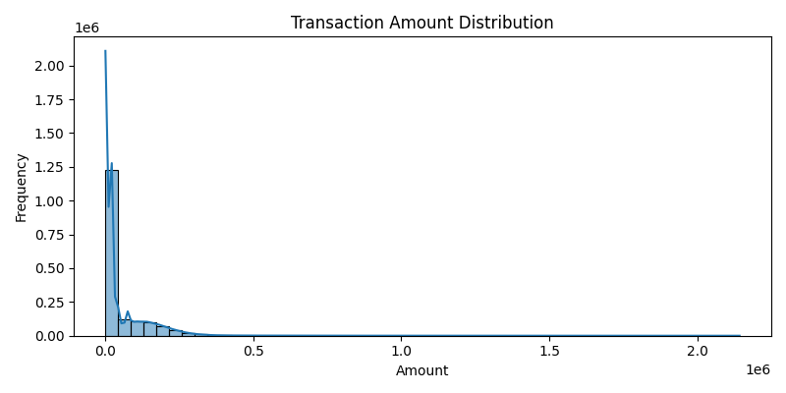
Transaction Amount Distribution

Slide 7
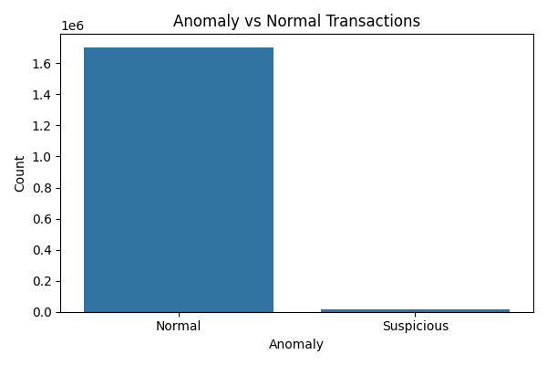
Anomaly vs Normal Transaction

Slide 8
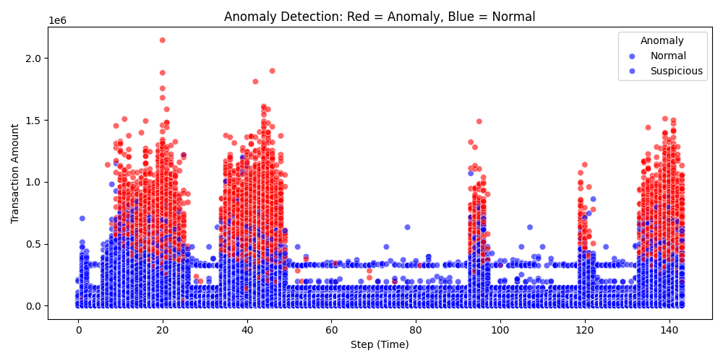
Anomaly Detection: Red = anomaly Blue = normal

Slide 9
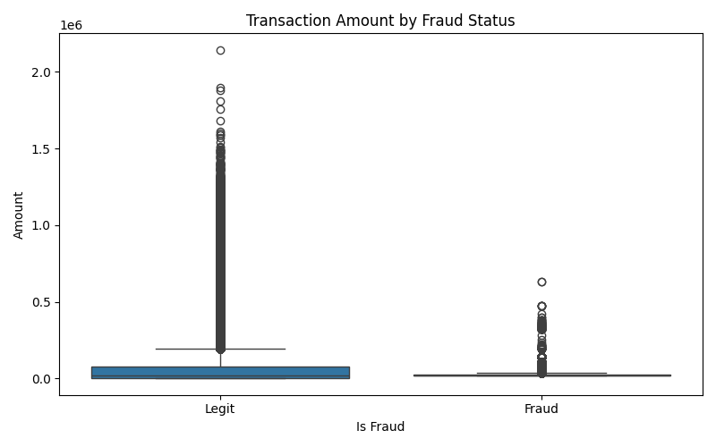
Transaction Amount by Fraud Status

Slide 10
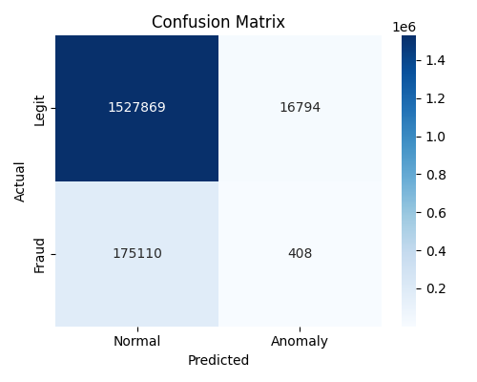
Confusion Matrix

Slide 11
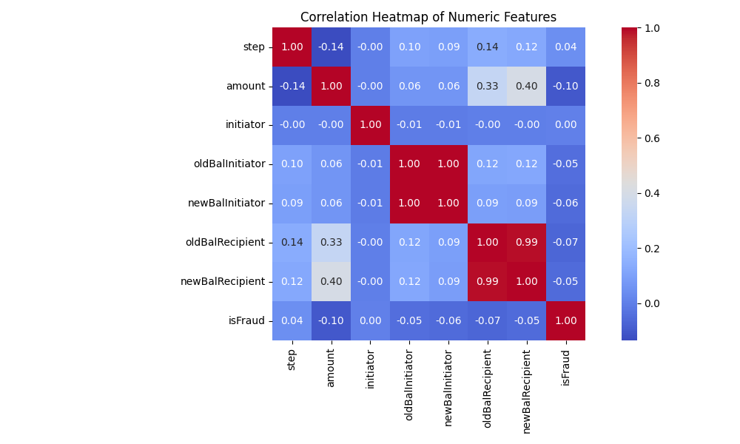
Correlation Heat Map

Slide 12
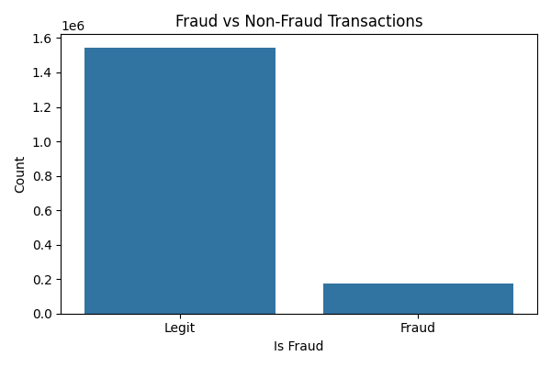
Fraud Vs Non Fraud Transactions

Slide 13
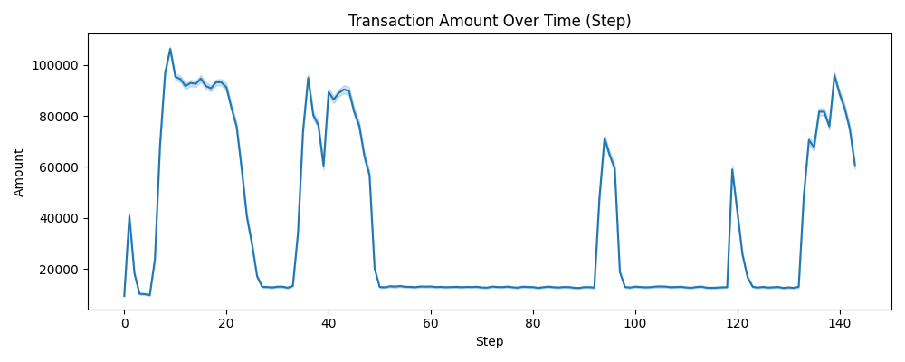
Transaction Amount Over Time

Slide 14
Anomaly Detection
Model: Isolation Forest (unsupervised)
Contamination = 0.01 (1% anomalies)
Added 'anomaly' column (0 = normal, 1 = suspicious)
Output file: anomaly_data.csv

Slide 15
Model Evaluation
Compared 'isFraud' vs 'anomaly'
Metrics: Confusion Matrix, Precision, Recall, F1-Score
Detected fraud with good precision.
Plot: confusion_matrix.png

Slide 16
Reporting with Power BI
Dashboard created to visualize:
Fraud count
Time trend
Amount distribution
Used clustered column charts and line charts

Slide 17
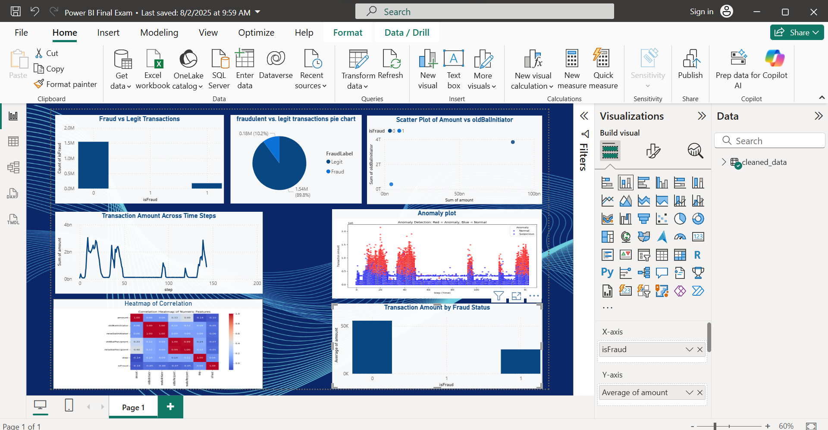
Power BI Dashboard

Slide 18
How the Project Works
Step-by-step flow:
Load & clean data
Visualize patterns
Apply anomaly detection
Label frauds
Visualize & report

Slide 19
Final Outputs & GitHub
Cleaned dataset
Anomaly detection CSV
Power BI Dashboard
Python scripts + README
Note: Add Google Drive link for large files.

Slide 20
Conclusion & Lessons Learned
Learned data cleaning, visualization, ML, evaluation
Detected frauds effectively with unsupervised ML
Presented results clearly with Power BI
Optional: Mention future improvements (e.g. use LSTM, integrate real-time alerts)

